Slide 1




OTC-32950-MS | Data-driven Workflow for Categorization of Brines Applied to a Pre-salt Field Mateus A. Fernandes / USP & Petrobras Prof. Dr. Márcio A. Sampaio / USP Prof. Dr. Eduardo Gildin / Texas A&M University

Slide 2


Agenda
Introduction
Objectives
Methods
Results
Conclusions
OTC-32950-MS • Data-driven Workflow for Categorization of Brines Applied to a Pre-salt Field • M. A. Fernandes

Slide 3
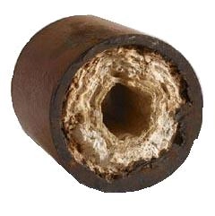
Introduction
The problems of characterization and prediction of the behavior of the Pre-Salt carbonate reservoirs are still relatively new – in particular those related to water production.
One of the most complex phenomena we deal with is the reactivity that occurs in porous media, the result of complex interactions between rock and fluids, considering their diverse compositions and characteristics throughout the reservoir and the mixture with injection water.
Some of those interactions can lead to problems like the deposition of scale.
OTC-32950-MS • Data-driven Workflow for Categorization of Brines Applied to a Pre-salt Field • M. A. Fernandes

Slide 4
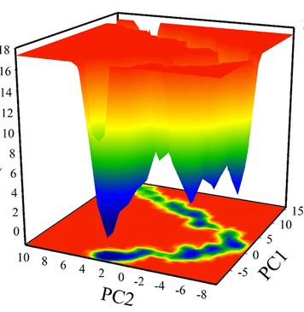
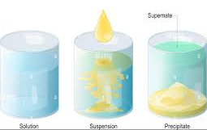
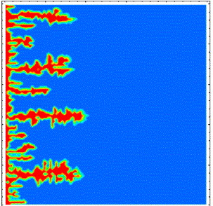
Introduction
In the literature, we can find approaches based on analytical, semi-empirical and numerical models studying the effects of that reactivity [Haghtalab et al., 2014]:
- Mass Balance - Solubility Product
- Phase Equilibria Equations - Free Energy of Systems
- Reactive Transport - Thermodynamical Simulation
In most of those cases, however, the solutions require great effort.
OTC-32950-MS • Data-driven Workflow for Categorization of Brines Applied to a Pre-salt Field • M. A. Fernandes

Slide 5

Introduction
Meanwhile, we have a vast amount of data available:
Data-Driven Methods
Chemical Analysis from water samples
Produced volumes
Real-time data from gauges
OTC-32950-MS • Data-driven Workflow for Categorization of Brines Applied to a Pre-salt Field • M. A. Fernandes

Slide 6
Agenda
Introduction
Objectives
Methods
Results
Conclusions
OTC-32950-MS • Data-driven Workflow for Categorization of Brines Applied to a Pre-salt Field • M. A. Fernandes

Slide 7
Objectives
To obtain a categorization of oil producing wells based on the characteristics of the surrounding brines.
That categorization can give us information about expected reactivities in regions of the reservoir and lead us to actions to prevent possible problems that can incur in production loss.
Our approach is data-based, using a model that has as inputs the analysis of chemical compositions of sampled fluids and some production data – not depending on physical-chemical equations or simulation models.
OTC-32950-MS • Data-driven Workflow for Categorization of Brines Applied to a Pre-salt Field • M. A. Fernandes

Slide 8
Agenda
Introduction
Objectives
Methods
Results
Conclusions
OTC-32950-MS • Data-driven Workflow for Categorization of Brines Applied to a Pre-salt Field • M. A. Fernandes

Slide 9

Workflow
Data Acquisition
Data Conditioning
Variables Selection
Spatial Data Interpolation
Dimensionality Reduction (PCA)
Clustering
Foto: Shutterstock

Slide 10
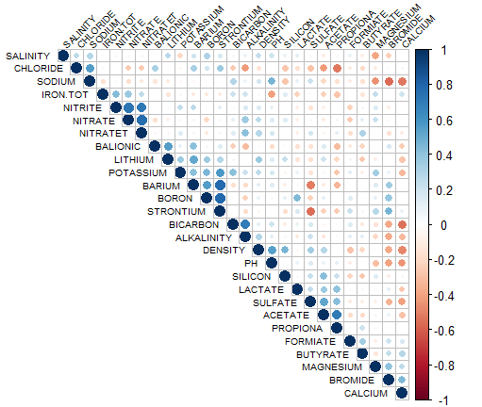
Data Acquisition and Conditioning
Our database for formation water analysis contains a total of 27 chemical components, but this large number can make it difficult to deal with in the feature extraction step (as we can see in the PCA).
OTC-32950-MS • Data-driven Workflow for Categorization of Brines Applied to a Pre-salt Field • M. A. Fernandes

Slide 11
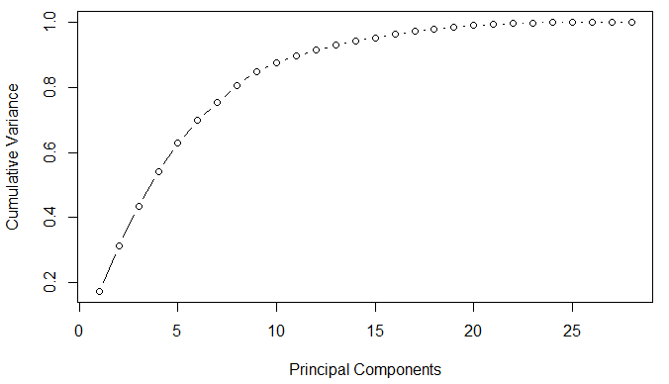
Data Acquisition and Conditioning
Our database for formation water analysis contains a total of 27 chemical components, but this large number can make it difficult to deal with in the feature extraction step (as we can see in the PCA).
OTC-32950-MS • Data-driven Workflow for Categorization of Brines Applied to a Pre-salt Field • M. A. Fernandes

Slide 12
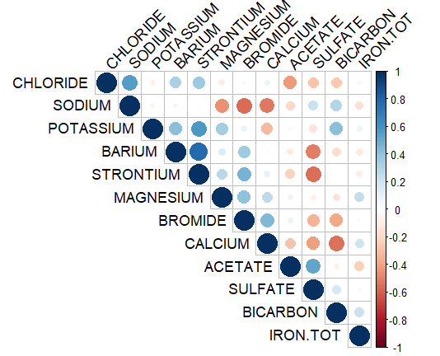
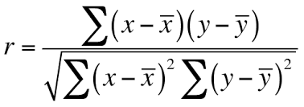
Data Acquisition and Conditioning
Our database for formation water analysis contains a total of 27 chemical components, but this large number can make it difficult to deal with in the feature extraction step (as we can see in the PCA).
After a preliminary correlation study and consulting the experts, we reduced it to 12 most relevant chemical components.
We see no redundancy among those variables and the PCA shows a better representation with fewer components.
OTC-32950-MS • Data-driven Workflow for Categorization of Brines Applied to a Pre-salt Field • M. A. Fernandes

Slide 13
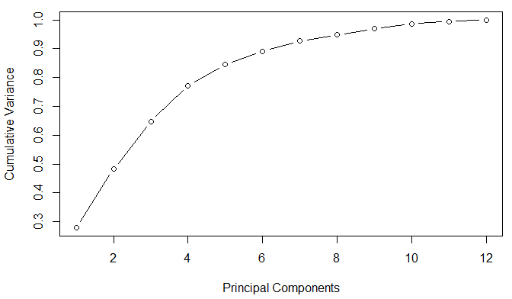
Data Acquisition and Conditioning
Our database for formation water analysis contains a total of 27 chemical components, but this large number can make it difficult to deal with in the feature extraction step (as we can see in the PCA).
After a preliminary correlation study and consulting the experts, we reduced it to 12 most relevant chemical components.
We see no redundancy among those variables and the PCA shows a better representation with fewer components.
OTC-32950-MS • Data-driven Workflow for Categorization of Brines Applied to a Pre-salt Field • M. A. Fernandes

Slide 14
Data Acquisition and Conditioning
Our database has an important characteristic of small intersection between the group of wells that had formation water sampled and analysed in laboratory (mostly injectors) and the group of wells that is more relevant to follow-up (producers).
Proposed solution: interpolation of data from the chemical analyses, using the spatial coordinates of the wells from which the samples were collected.
We then converted the data for the type raster, associating values to positions in a regular grid.
Sampled Wells
Relevant Wells for Reactivity
OTC-32950-MS • Data-driven Workflow for Categorization of Brines Applied to a Pre-salt Field • M. A. Fernandes

Slide 15
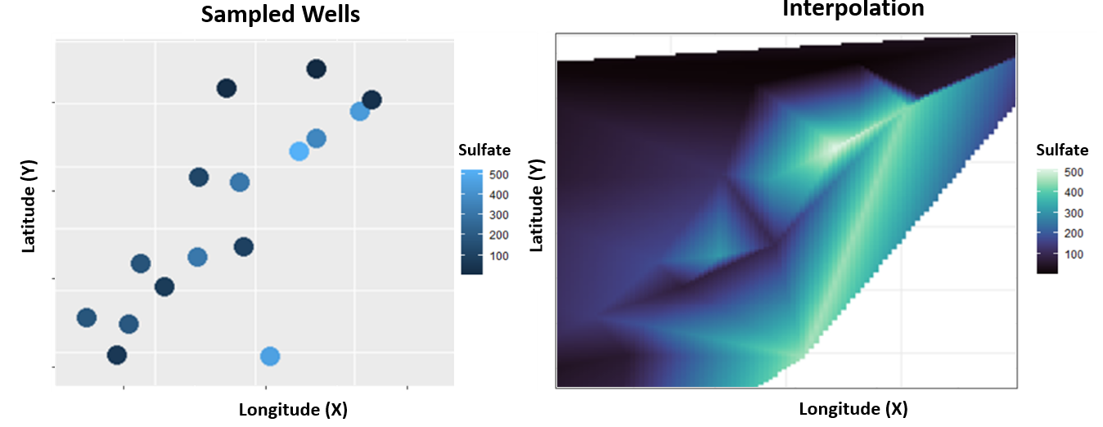
Spatial Interpolation – Sulfate
OTC-32950-MS • Data-driven Workflow for Categorization of Brines Applied to a Pre-salt Field • M. A. Fernandes

Slide 16
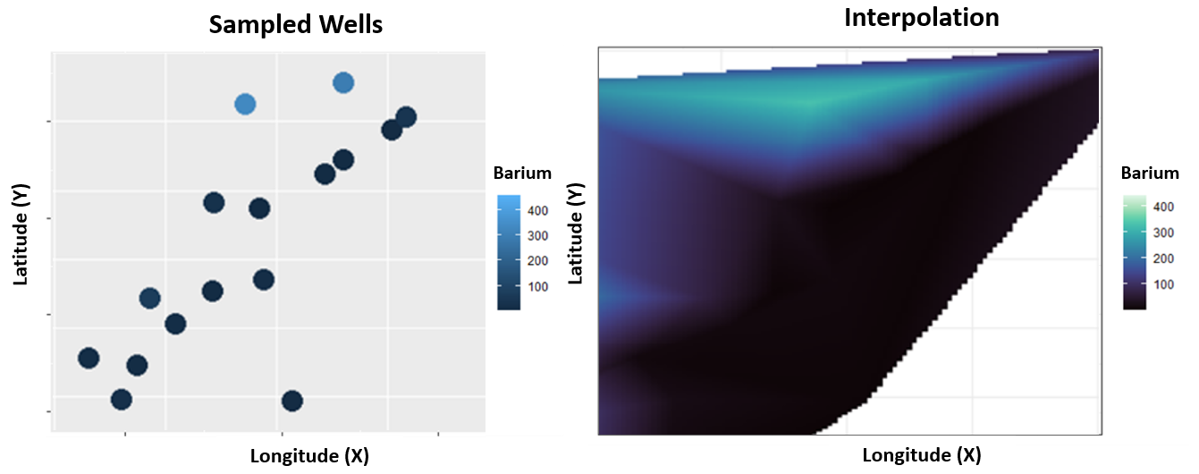
Spatial Interpolation – Barium
OTC-32950-MS • Data-driven Workflow for Categorization of Brines Applied to a Pre-salt Field • M. A. Fernandes

Slide 17
Calculating for non-sampled Wells
OTC-32950-MS • Data-driven Workflow for Categorization of Brines Applied to a Pre-salt Field • M. A. Fernandes

Slide 18
Agenda
Introduction
Objectives
Methods
Results
Conclusions
OTC-32950-MS • Data-driven Workflow for Categorization of Brines Applied to a Pre-salt Field • M. A. Fernandes

Slide 19
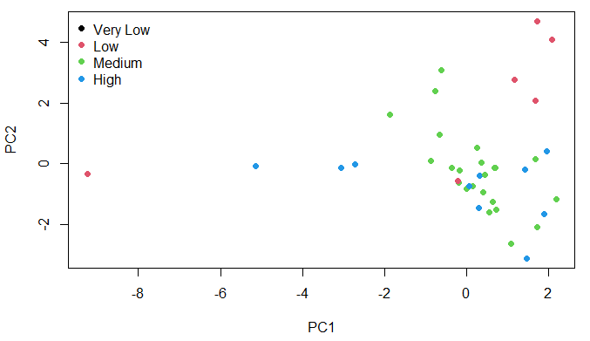
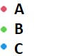
Principal Component Analysis
PCA: Orthogonal transformation of the variables, mapping them to a new space where the first component maximizes the captured variance and each subsequent component captures the maximum possible of the residual variance, representing a non-correlated direction in space.
We used this method with our interpolated dataset, reducing dimensionality from 12 to 02:
Reference based on experts’ analyses (multidisciplinary)
OTC-32950-MS • Data-driven Workflow for Categorization of Brines Applied to a Pre-salt Field • M. A. Fernandes

Slide 20
Principal Component Analysis
OTC-32950-MS • Data-driven Workflow for Categorization of Brines Applied to a Pre-salt Field • M. A. Fernandes

Slide 21
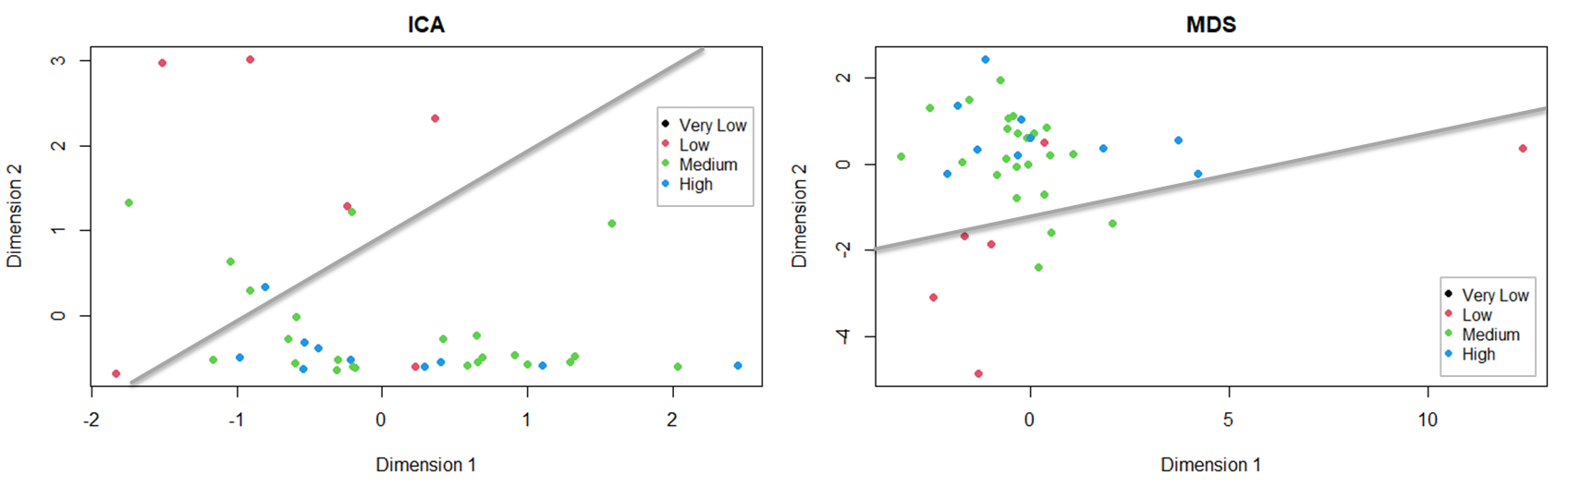
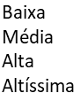
Other Dimensionality Reduction Methods
ICA (Independent Component Analysis) MDS (Multidimensional Scaling)
OTC-32950-MS • Data-driven Workflow for Categorization of Brines Applied to a Pre-salt Field • M. A. Fernandes

Slide 22
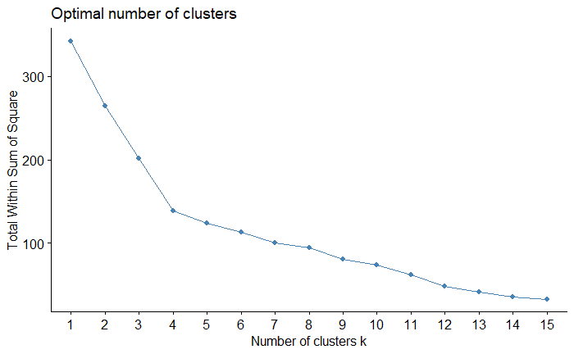
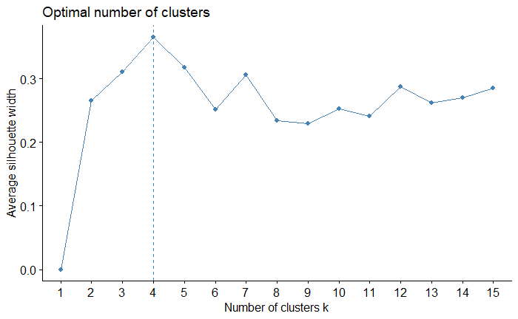
Clustering: K-means
K-means: Method in which groups (clusters) are formed by minimizing the sum of the squares of the distances of each sample to the centroid of its respective group.
Optimal number of clusters can be obtained calculating some metrics, as the sum of the squares of the distances of each point to the centroid of its respective cluster (evaluating cohesion of the clusters), and the silhouette coefficient (evaluating separation).
OTC-32950-MS • Data-driven Workflow for Categorization of Brines Applied to a Pre-salt Field • M. A. Fernandes

Slide 23
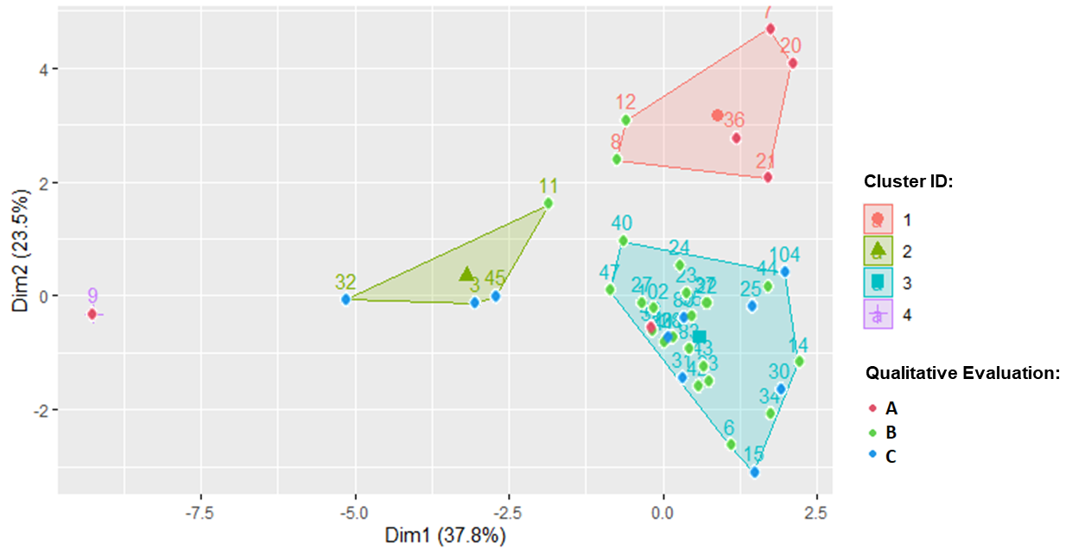
Clustering: K-means
For our dataset, the optimal number is k = 4, and with that we obtained clusters highly correlated to our references.
OTC-32950-MS • Data-driven Workflow for Categorization of Brines Applied to a Pre-salt Field • M. A. Fernandes

Slide 24
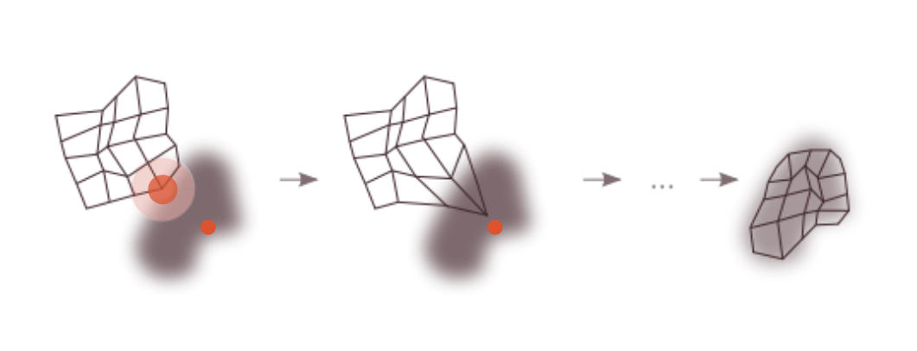
Self-Organizing Maps
We also evaluated Kohonen’s Self-Organizing Maps to knowledge extraction.
In this method, a grid with dimensions defined by the user is adapted to the dataset in an iterative process that is also focused on minimizing Euclidian distances.
Source: rubikscode.net
OTC-32950-MS • Data-driven Workflow for Categorization of Brines Applied to a Pre-salt Field • M. A. Fernandes

Slide 25
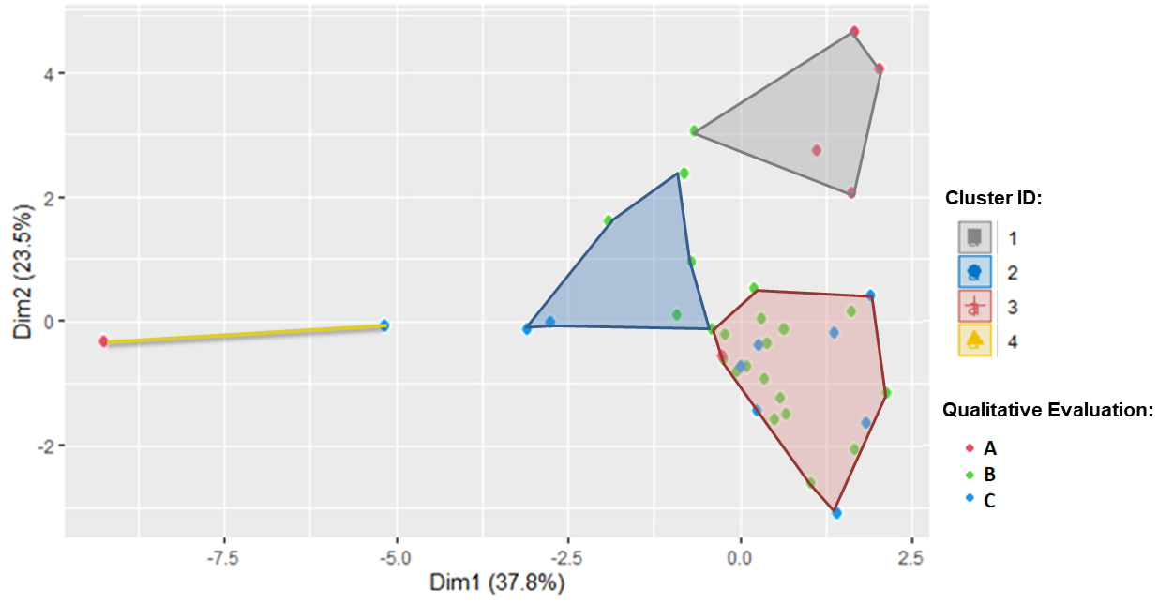
Self-Organizing Maps
To be consistent with the number of clusters we used in the K-means, we defined our grid as 2x2.
The results are highly correlated to what we obtained using the K-means:
OTC-32950-MS • Data-driven Workflow for Categorization of Brines Applied to a Pre-salt Field • M. A. Fernandes

Slide 26
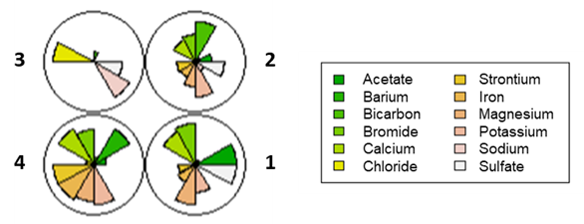
Self-Organizing Maps
We can also obtain the codebook vectors of each group. Those vectors help us identify the main features to be observed in each group:
OTC-32950-MS • Data-driven Workflow for Categorization of Brines Applied to a Pre-salt Field • M. A. Fernandes
Notes:
We can also obtain from that mapping the codebook vectors of each group. It helps us understand what the main features are to be observed in each group, comparing the mean values of each of their components. We present these results in Figure 14, and from that we can conclude, for example, that Cluster 3 concentrates wells with patterns of reactivity that are different from other groups, and that these wells are characterized by having high levels of Chloride and Sodium in their vicinity, at original conditions.

Slide 27
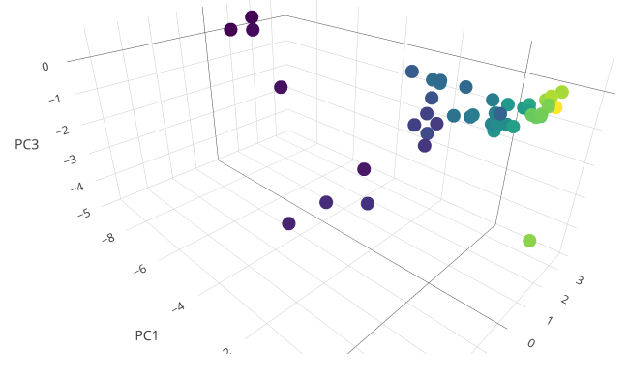
Produced Water – Well 1
More Recent
Oldest
OTC-32950-MS • Data-driven Workflow for Categorization of Brines Applied to a Pre-salt Field • M. A. Fernandes

Slide 28
Produced Water – Well 2
More Recent
Oldest
OTC-32950-MS • Data-driven Workflow for Categorization of Brines Applied to a Pre-salt Field • M. A. Fernandes

Slide 29
Agenda
Introduction
Objectives
Methods
Results
Conclusions
OTC-32950-MS • Data-driven Workflow for Categorization of Brines Applied to a Pre-salt Field • M. A. Fernandes

Slide 30
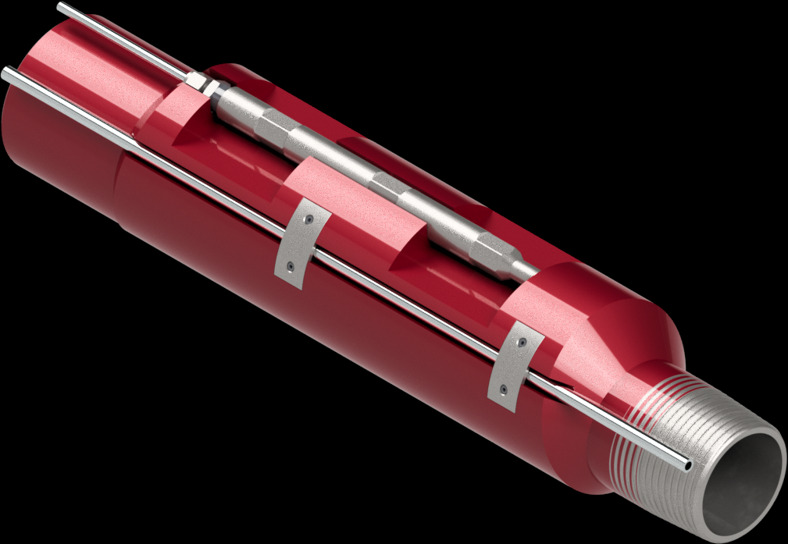

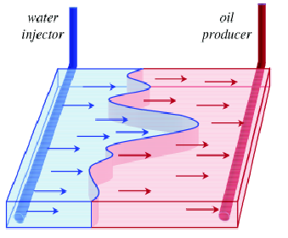
Recommendations
Source: praxiscompletion.com
Source: pexels.com
Source: DOI:10.3384/ECP17142735
Ensure operability
of chemical injection, enabling the application of scale inhibitors in the correct frequency
Sampling and lab analysis
to monitor production water composition and the presence of solids, and to better characterize formation water
Injection Management
including daily rates and periodicity of WAG cycles for the influent wells
OTC-32950-MS • Data-driven Workflow for Categorization of Brines Applied to a Pre-salt Field • M. A. Fernandes

Slide 31
Conclusions
As the water cut increases in the pre-salt production, as do the mixture of formation and injected waters, we will require more rigor in monitoring, with greater demand for laboratory analysis and simulations.
To prevent problems that could lead to production loss we’ll be required to ensure subsea Chemical injection and, eventually, perform workovers, what can incur in relevant operational costs.
The method we presented can be a simple and fast way to group wells with similar characteristics and the knowledge extraction can be useful to drive our efforts and resources.
OTC-32950-MS • Data-driven Workflow for Categorization of Brines Applied to a Pre-salt Field • M. A. Fernandes

Slide 32
Acknowledgements
The authors would like to acknowledge the contributions of Luciano Endres, Roni Dalla Costa, Tetsuo Miyakawa, and Daniel Batello.
We thank the Laboratory of Reservoir Simulation and Management (LASG), the University of São Paulo (USP) and Texas A&M University.
We also would like to thank Petrobras for the permission to use proprietary data in this paper.
OTC-32950-MS • Data-driven Workflow for Categorization of Brines Applied to a Pre-salt Field • M. A. Fernandes

Slide 33
References
Amirlatifi, A., Block, G., Abou-Sayed, O. et al. 2018. Well Performance in New Frontiers: Reducing Risk and Uncertainty through Large Scale Data Analytics. Presented at the Offshore Technology Conference, Houston, 30 April. OTC-28934-MS. https://doi.org/10.4043/28934-MS.
Böhner, J. and Bechtel, B. 2018. GIS in climatology and Meteorology. In book: Reference Module in Earth Systems and Environmental Sciences. Elsevier. http://dx.doi.org/10.1016/B978-0-12-409548-9.09633-0.
Boslaugh, S. and Watters, P.A. 2008. Statistics in a Nutshell: A Desktop Quick Reference. Sebastopol, California: O'Reilly Media. ISBN-13: 978-0596510497.
Chen, C., Han, X., Yang, M. et al. 2019. A New Artificial Intelligence Recognition Method of Dominant Channel Based on Principal Component Analysis. Presented at the SPE/IATMI Asia Pacific Oil & Gas Conference and Exhibition, Bali, 29-31 October. SPE-196295-MS. https://doi.org/10.2118/196295-MS.
Chen, Z., Yu, W., Liang, J.-T. et al. 2021. Application of statistical machine learning clustering algorithms to improve EUR predictions using decline curve analysis in shale-gas reservoirs. Journal of Petroleum Science and Engineering 208 (B): 109216. Elsevier BV. https://doi.org/10.1016/j.petrol.2021.109216.
Haddadpour, H. and Niri, M.E. 2021. Uncertainty assessment in reservoir performance prediction using a two-stage clustering approach: Proof of concept and field application. Journal of Petroleum Science and Engineering 204: 108765. Elsevier BV. https://doi.org/10.1016/j.petrol.2021.108765.
Haghtalab, A., Kamali, M.J. and Shahrabadi, A. 2014. Prediction mineral scale formation in oil reservoirs during water injection. Fluid Phase Equilibria 373: 43-54. Elsevier BV. https://doi.org/10.1016/j.fluid.2014.04.001.
Kohonen, T. 2001. Self-Organizing Maps. Heidelberg, Gernamy: Springer Berlin. https://doi.org/10.1007/978-3-642-56927-2.
OTC-32950-MS • Data-driven Workflow for Categorization of Brines Applied to a Pre-salt Field • M. A. Fernandes

Slide 34
References
Oliveira, G.P., Santos, M.D. and Roque, W.L. 2020. Constrained clustering approaches to identify hydraulic flow units in petroleum reservoirs. Journal of Petroleum Science and Engineering 186: 106732. Elsevier BV. https://doi.org/10.1016/j.petrol.2019.106732.
R Core Team. 2021. R: A language and environment for statistical computing. Vienna, Austria: R Foundation for Statistical Computing. https://www.R-project.org/.
Ribeiro, F.A.L., Mantovani, G.A., Poppi, R.J. et al. 2013. PCA: Uma Ferramenta para Identificação de Traçadores Químicos para Água de Formação e Água de Injeção Associadas à Produção de Petróleo. Química Nova 36 (9): 1281-1287.
Siena, M., Guadagnini, A., Rossa, E.D. et al. 2016. A Novel Enhanced-Oil-Recovery Screening Approach Based on Bayesian Clustering and Principal-Component Analysis. SPE Reservoir Evaluation & Engineering 19: 382-390. SPE-174315-PA. https://doi.org/10.2118/174315-PA.
Tan, P.N., Steinbach, A. and Kumar, V. 2018. Introduction to Data Mining. The Morgan Kaufmann Series in Data Management Systems. https://www-users.cs.umn.edu/~kumar001/dmbook/index.php.
Wang, D., Li, Y., Hu, Y. et al. 2016. Integrated dynamic evaluation of depletion-drive performance in naturally fractured-vuggy carbonate reservoirs using DPSO–FCM clustering. Fuel 181: 996-1010. Elsevier BV. https://doi.org/10.1016/j.fuel.2016.05.009.
Wasser, L.A., Jones, M.A., Brym, Z. et al. 2021. Raster 00: Intro to Raster Data in R. Neon Science. https://www.neonscience.org/resources/learning-hub/tutorials/dc-raster-data-r.
Wehrens, R. and Buydens, L.M.C. 2007. Self- and Super-organizing Maps in R: The Kohonen Package. Journal of Statistical Software 21 (5): 1-19. American Statistical Association. http://dx.doi.org/10.18637/jss.v021.i05.
OTC-32950-MS • Data-driven Workflow for Categorization of Brines Applied to a Pre-salt Field • M. A. Fernandes

Slide 35

matfernan@usp.br

